Slide 1
ShipStation Provider
Participants:
Neha Neha
Virat Sagar

Slide 2
ShipStation
What is webMethods CloudStreams Provider for ShipStation
ShipStation is a SaaS (Software as a Service) shipping platform that allows you to manage all your small parcel and LTL shipping needs in one place.
ShipStation notifies the selling channel and the customer of the shipment and provides tools to track shipments and manage returns.
ShipStation also provides tools to manage shipping workflow, track processes to eliminate confusion and mistakes, and use powerful automation to minimize most of the manual work.

Slide 3
ShipStation
Connector capabilities and how it can benefit users
The WmShipStationProvider connector developed using cloudstreams helps to perform various operations that benefits the users to manage their orders and shipping details . Using the below resources created, users can place new order, update the existing order , can be notified when a new order is created using webhook.
Create Update Order : This method can be used to create a new order or update an existing order. If the orderKey is specified, ShipStation will attempt to locate the order with the specified orderKey. If found, the existing order with that key will be updated. If the orderKey is not found, a new order will be created with that orderKey.
Get Order : Retrieve a single order from the database.
Get Warehouse : Returns a list of active Ship From Locations (formerly known as warehouses) on the ShipStation account.
Update Warehouse : Updates an existing Ship From Location (formerly known as warehouse).
Create Label for Order : Creates a shipping label for a given order. The labelData field returned in the response is a base64 encoded PDF value. Simply decode and save the output as a PDF file to retrieve a printable label.

Slide 4
ShipStation
Connector capabilities and how it can benefit users
6. Create Warehouse : Adds a Ship From Location (formerly known as warehouse) to your account.
7. Hold Order Until : This method will change the status of the given order to On Hold until the date specified, when the status will automatically change to Awaiting Shipment.
8. Mark an Order as Shipped : Marks an order as shipped without creating a label in ShipStation.
9. Delete Order : Removes order from ShipStation's UI. Note this is a "soft" delete action so the order will still exist in the database, but will be set to inactive.
10. Delete Warehouse : Removes a warehouse from ShipStation's UI.
11. Subscribe Webhook : Subscribes to a specific type of webhook.
12. UnSubscribe Webhook : Unsubscribes from a certain webhook.
13. List Webhooks : Retrieves a list of registered webhooks for the account.

Slide 5
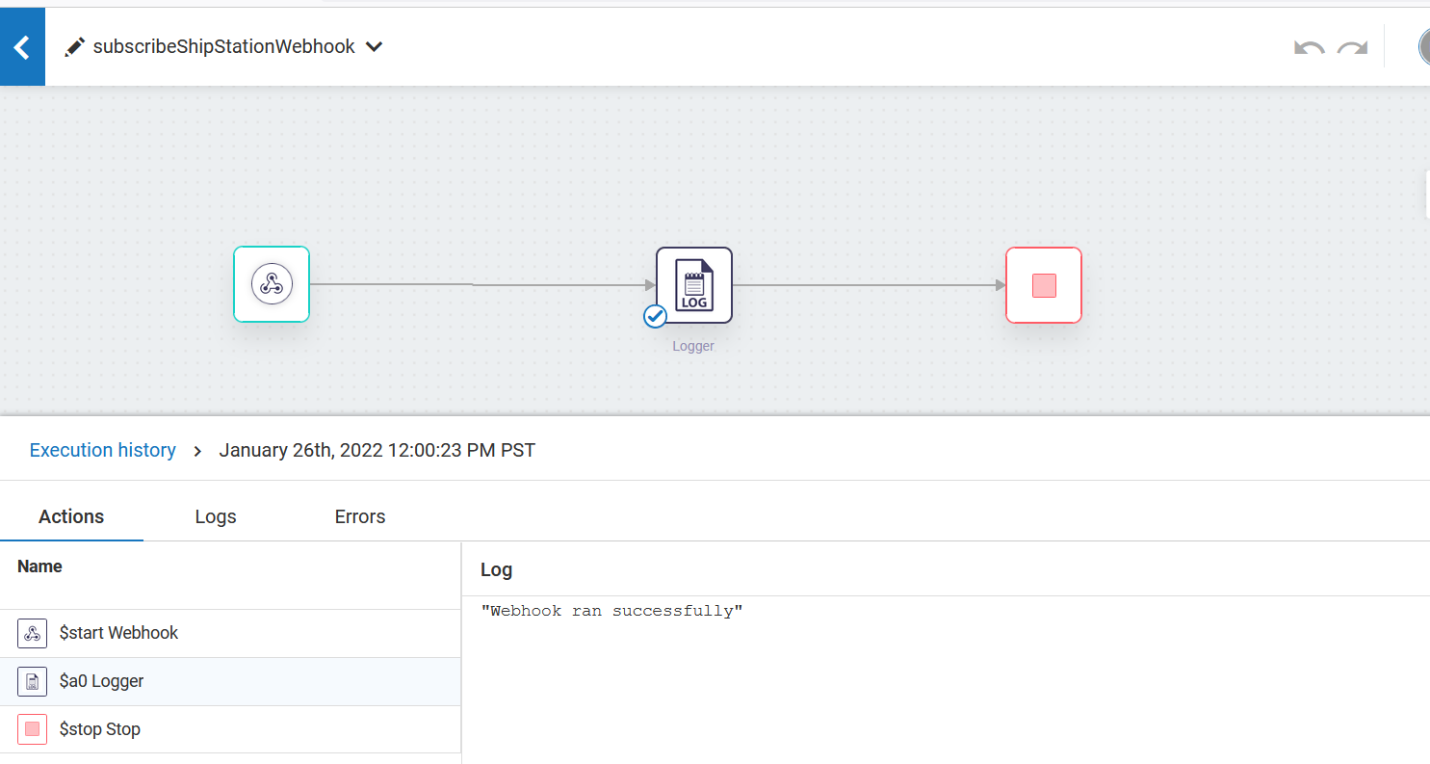
Screenshots for workflow
Workflow to show webhook capability

Slide 6
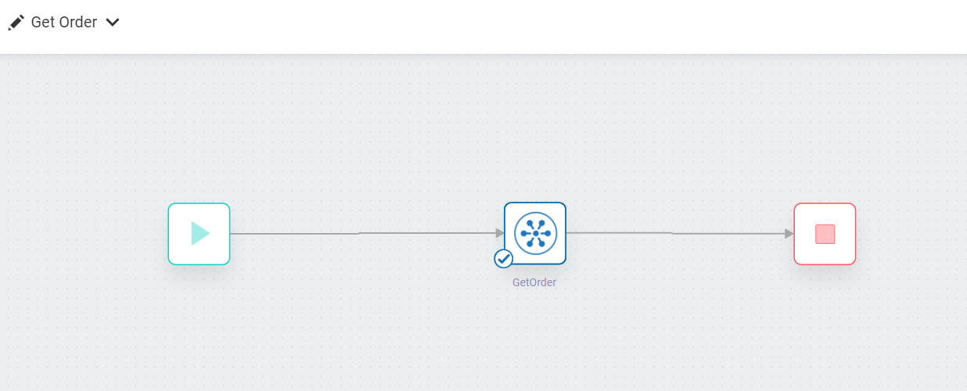
Screenshots for workflow
2. Workflow for getOrder action

Slide 7
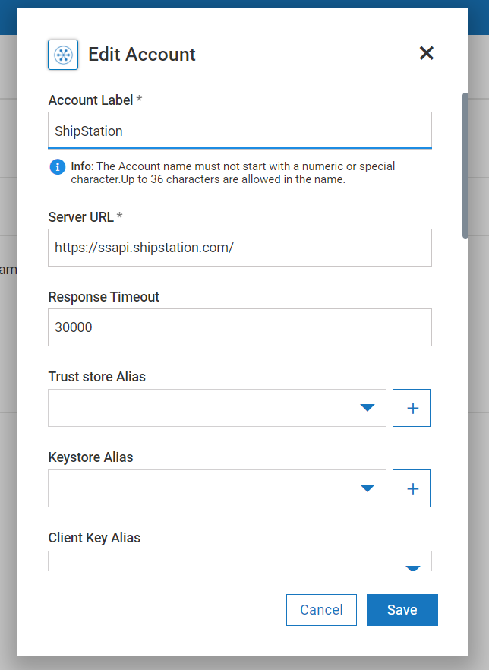
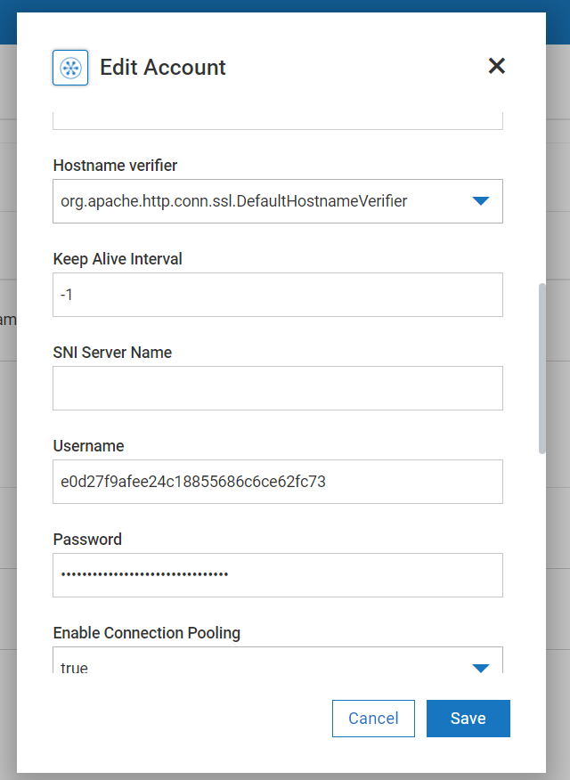
Screenshots for workflow
3. ShipStation account configuration in webMethods.io

